Slide 1


SALES REPORTS

Slide 2
Content
BUSINESS OVERVIEW
Highlight
Our Team
REVENUE PERFORMANCE
Which region is generating the highest revenue, and which region is generating the lowest?
What is the monthly trend of revenue, which months have faced the biggest increase/decrease?
Which months generated the most revenue? Is there a seasonality in sales?
Who are the top customers and how much do they contribute to the total revenue? Is the business dependent on these customers or is the customer base diversified?
CUSTOMERS PERFORMANCE
What is the percentage of customers who are repeating their orders? Are they ordering the same products or different?
For the repeat customers, how long does it take for them to place the next order after being delivered the previous one?
What revenue is being generated from the customers who have ordered more than once?
Who are the customers that have repeated the most? How much are they contributing to revenue?

Slide 3





36
Countries
HIGHLIGHTS
419
Customers
2783
PRODUCTS
1.52M
Total Revenue
889k
Sum of quantity

Slide 4




Our team
Martins Isabella
CEO
Tophila Iwuala
CMO
Manasseh Uzor
Product Manager
Isadora Elijah
Financial Manager

Slide 5
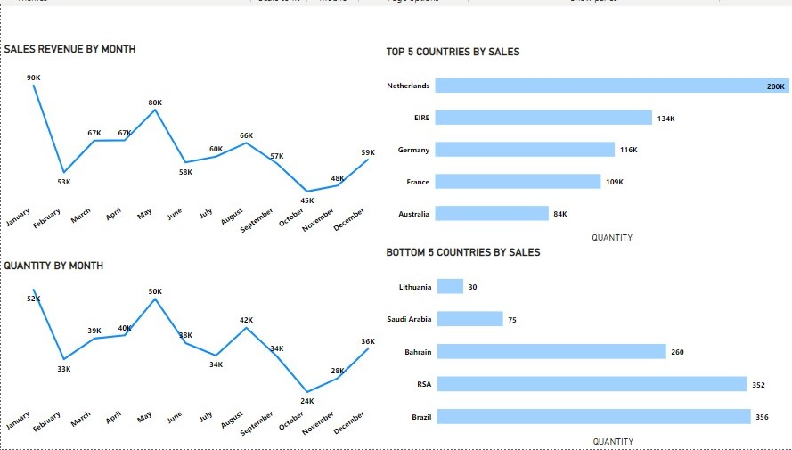
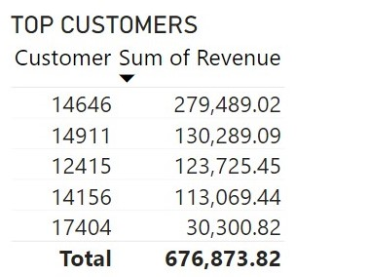
REVENUE PERFORMANCE

Slide 6
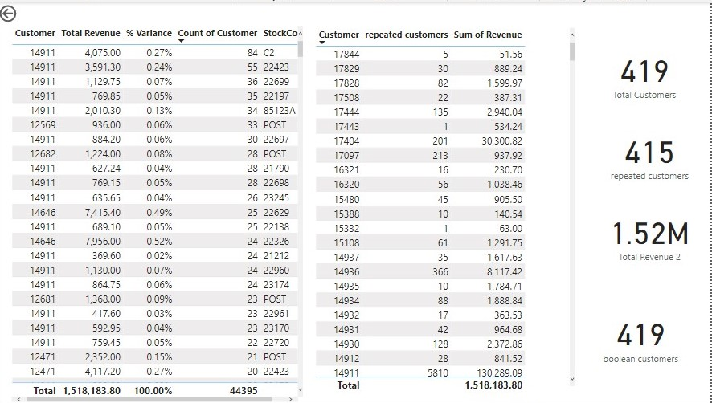
CUSTOMERS PERFORMANCE

